Slide 1
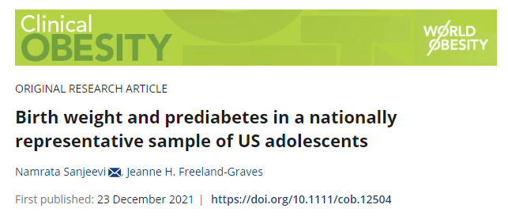
Reproduction and Analysis of Birth Weight and Prediabetes Associations
https://doi.org/10.1111/cob.12504

Slide 2
Overview
Conducted from 2005 to 2016.
Divided into six segments: 2005–2006, 2007–2008, 2009–2010, 2011–2012, 2013–2014, and 2015–2016.
Data segments labeled D, E, F, G, H, and I respectively.

Slide 3
Components Available:
Each segment provides six component datasets:
Demographics Data
Dietary Data
Examination Data
Laboratory Data
Questionnaire Data
Limited Access Data

Slide 4
Variables of Interest:
Demographics:
Education (DMDHREDU)
Income to Poverty Ratio (INDFMPIR)
Gender (RIAGENDR)
Age (RIDAGEYR)
Race (RIDRETH1)
Examination (Body Measures):
Height (BMXHT)
BMI (BMXBMI)
Waist Circumference (BMXWAIST)
Questionnaire (Early Childhood & Diabetes):
Birth Weight (ECD070A, ECD070B)
Smoking While Pregnant (ECQ020)
Diabetes Diagnosis (DIQ010)
Laboratory (Glycohemoglobin, Plasma Fasting Glucose & Insulin, Oral Glucose Tolerance Test):
Glycohemoglobin (LBXGH)
Fasting Plasma Glucose (LBDGLUSI)
Postprandial Plasma Glucose (LBDGLTSI)
Fasting Time Length (PHAFSTHR/PHAFSTMN)

Slide 5
Data Processing Notes:
Conversion formula: HbA1c = (lbxgh - 2.15) * 10.929 (hba1c in mmol/mol)
HbA1c units in the paper: mmol/mol
Glycohemoglobin in the database: %
Birth weight conversion: (pounds * 16 + ounces) = ounces, ounces * 28.3495 = grams

Slide 6
Data Processing:
Retained only non-missing values for HbA1c, fasting plasma glucose (FPG), 2-h postprandial plasma glucose (2hrPG), and birth weight.
Excluded individuals with diabetes (FPG≥7 mmol/L, 2hrPG ≥ 11.1 mmol/L, or HbA1c ≥ 48 mmol/mol).
Prediabetes defined as:
Doctor-diagnosed borderline diabetes
FPG: 5.6–6.9 mmol/L
2hrPG: 7.8–11.0 mmol/L
HbA1c: 39–46 mmol/mol.

Slide 7
Sample Size Comparison
work | Low birth weight (<2500 g) | Normal birth weight (2500–3999 g) | High birth weight (≥4000 g)
Sanjeevi & Freeland-Graves work | 133 | 1117 | 146
my analysis | 133 | 1122 | 147

Slide 8
Comparison of Key Variables
variables | Sanjeevi & Freeland-Graves work |  | my analysis
 | Adolescents With prediabetes | Adolescents without prediabetes | Adolescents With prediabetes | Adolescents without prediabetes
N | 371 | 1025 | 360 | 1042
age | 13.5 | 13.6 | 13.5 | 13.4
sex(male, %) | 65.0 | 48.7 | 63.1 | 48.7
Race(Non-Hispanic White, %) | 52.9 | 60.4 | 26.7 | 27.2
Household reference person’s education(College graduate or Above, %) | 20.3 | 29.0 | 18.1 | 19.9
Maternal smoking during Pregnancy (yes, %) | 17.2 | 14.4 | 14.0 | 12.9

Slide 9
‘Race’ Outliers
Original sample distribution from NHANES (2005-2016)
Code/ Value | Value Description | 2005-2006 | 2007-2008 | 2009-2010 | 2011-2012 | 2013-2014 | 2015-2016 | Total | Percentage
1 | Mexican American | 2847 | 2157 | 2384 | 1355 | 1730 | 1921 | 12394 | 20.3%
2 | Other Hispanic | 349 | 1201 | 1133 | 1076 | 960 | 1308 | 6027 | 9.9%
3 | Non-Hispanic White | 3928 | 4115 | 4420 | 2973 | 3674 | 3066 | 22176 | 36.4%
4 | Non-Hispanic Black | 2710 | 2211 | 1957 | 2683 | 2267 | 2129 | 13957 | 22.9%
5 | Other Race - Including Multi-Racial | 514 | 465 | 643 | 1669 | 1544 | 1547 | 6382 | 10.5%
* The proportion of Non-Hispanic Whites is 45.7% when only Mexican Americans, Non-Hispanic Whites, and Non-Hispanic Blacks are considered in the calculation

Slide 10
Table 2: Comparison of Results
Group(Odds ratio [95% CI]) |  | Low birth weight | my analysis | High birth weight | my analysis
Model 1 | All adolescents (n=1396) (n=1402) | 2.01 (1.13,3.57)* | 1.62 (1.08, 2.43)*** | 0.81 (0.48, 1.37) | 0.92 (0.60, 1.39)***
Model 2 |  | 1.96 (1.12, 3.44)* | 1.64 (1.09, 2.46)*** | 0.79 (0.46,1.35) | 0.87 (0.57, 1.33)***
Model 3 |  | 1.93 (1.10, 3.38)* | 1.62 (1.07, 2.44)*** | 0.72(0.43,1.20) | 0.85 (0.55, 1.30)***
Model 4 | Males (n=732) (n=734) | 2.55 (1.05, 6.20)* | 1.60 (0.91, 2.82)*** | 0.87 (0.48,1.59) | 1.01 (0.62, 1.66)
Model 5 |  | 2.44 (1.02, 5.83)* | 1.61 (0.91, 2.83)*** | 0.85 (0.46,1.58) | 1.01 (0.62, 1.67)*
Model 6 |  | 2.40 (1.02, 5.67)* | 1.56 (0.89, 2.76)*** | 0.84 (0.46, 1.56) | 1.01 (0.61, 1.66)*
Model 4 | Females (n=664) (n=668) | 1.39 (0.62, 3.13) | 1.62 (0.89, 2.93) | 0.66 (0.22, 1.93) | 0.71 (0.31, 1.65)
Model 5 |  | 1.38 (0.60, 3.16) | 1.65 (0.91, 3.01)** | 0.64 (0.21,1.96) | 0.55 (0.23, 1.33)*
Model 6 |  | 1.37 (0.60, 3.13) | 1.68 (0.92, 3.07)** | 0.38 (0.14, 1.08) | 0.48 (0.19, 1.22)**

Slide 11
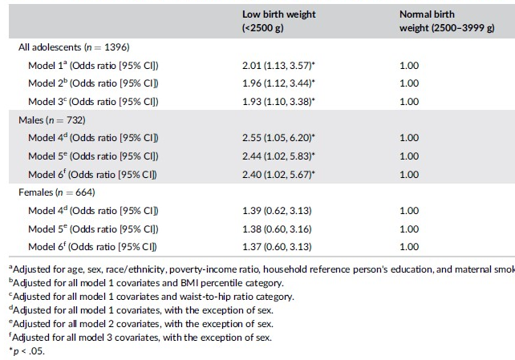
Typo in the original paper
Adjusted for all model 1 covariates and waist-to-hip ratio category.
Since hip circumference data were not collected during the study period and are available only from 2017 onwards.
The term "waist-to-hip ratio category" should be replaced with "waist-to-height ratio category".

Slide 12
Table 2: consistencies
Both studies show a higher odds ratio for low birth weight across all models, indicating a consistent association with an increased risk.
The direction of association for high birth weight remains the same in both analyses, typically showing reduced odds ratios compared to the normal weight group.

Slide 13
Table 2: inconsistencies
My analysis consistently reports lower odds ratios for low birth weight, which could be due to differences in data handling or sample size.
For high birth weight in males and females, the odds ratios are closer to 1 or higher than those in the original study, suggesting a potential discrepancy in sample characteristics or analytical methods.

Slide 14
Table 3: Comparison of Results
Group(Odds ratio [95% CI]) | BMI Percentile (<85th percentile)n=861 | my analysis n=864 | BMI Percentile (≥85th percentile)n=532 | my analysis n=535
Low birth weight | 1.76 (0.76, 4.05) | 1.54 (0.90, 2.63)*** | 2.13 (1.01, 4.49)* | 1.73 (0.91, 3.27)**
High birth weight | 1.11 (0.57, 2.18) | 1.11 (0.64, 1.92)*** | 0.48 (0.22, 1.06) | 0.67 (0.35, 1.30)**
 | Waist-to-Height Ratio (≤0.5)n=893 | n=895 | Waist-to-Height Ratio (>0.5)n=494 | n=498
Low birth weight | 1.58 (0.67, 3.71) | 1.50 (0.87, 2.59)*** | 2.35 (1.15, 4.82)* | 1.82 (0.96, 3.44)**
High birth weight | 0.93 (0.50, 1.71) | 0.96 (0.56, 1.64)*** | 0.41 (0.15, 1.12) | 0.75 (0.37, 1.51)*

Slide 15
Table 3: consistencies
BMI Percentile: Both analyses show a similar trend for low birth weight increasing prediabetes risk at the ≥85th percentile.
Waist-to-Height Ratio: Both studies agree that a higher ratio correlates with increased prediabetes risk in low birth weight individuals.

Slide 16
Table 3: inconsistencies
Sample Size Variation: Slight differences in the number of subjects included in each category may lead to statistical variations in the odds ratios and confidence intervals calculated.
Data Processing Methods: Divergence in approaches to handling missing data, outliers, or the inclusion criteria for study participants might lead to different analytical outcomes.
Model Specification: Variations in the statistical models used, including the covariates adjusted for in the logistic regression, can result in different odds ratios. Even minor differences in the model's specification can lead to substantial changes in the results, particularly in the width of the confidence intervals.

